Slide 1
INTRODUCTION TO
ALGORITHMS
FOURTH EDITION

Slide 2
LECTURE NOTES FOR CHAPTER 17
Augmenting Data Structures

Slide 3
CHAPTER 17 OVERVIEW
It’s unusual to have to design an all-new data structure from scratch.
It’s more common to take a data structure that you know and store additional information in it.
With the new information, the data structure can support new operations.
But you have to figure out how to correctly maintain the new information without loss of efficiency.
We’ll look at a couple of situations in which we augment red-black trees.

Slide 4
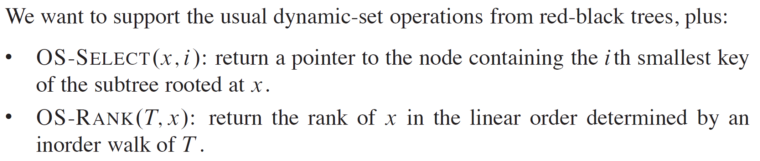
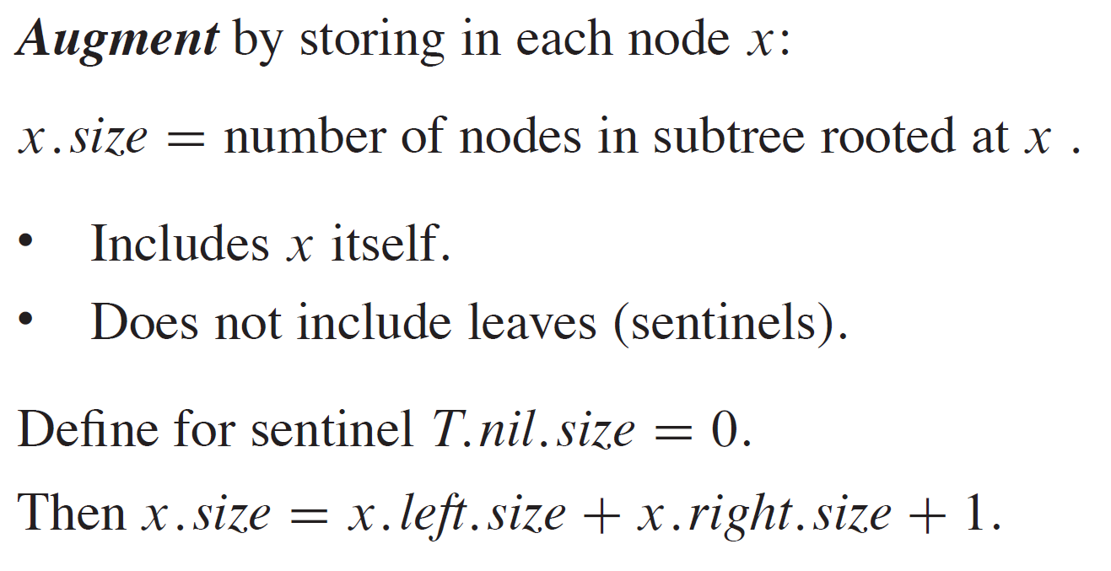
DYNAMIC ORDER STATISTICS

Slide 5
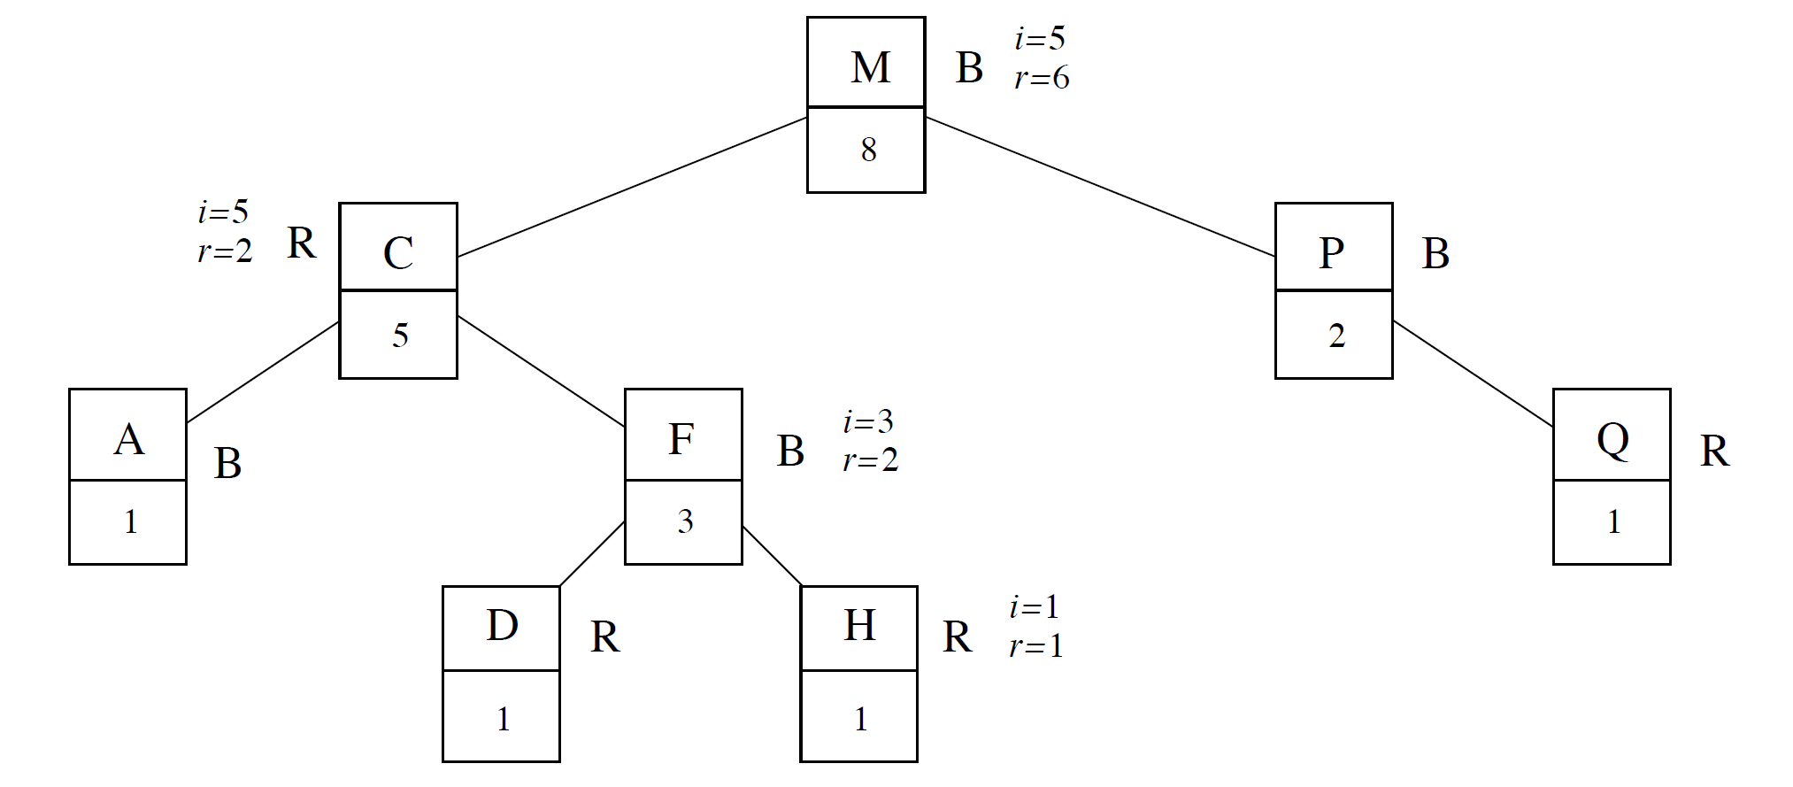
DYNAMIC ORDER STATISTICS

Slide 6
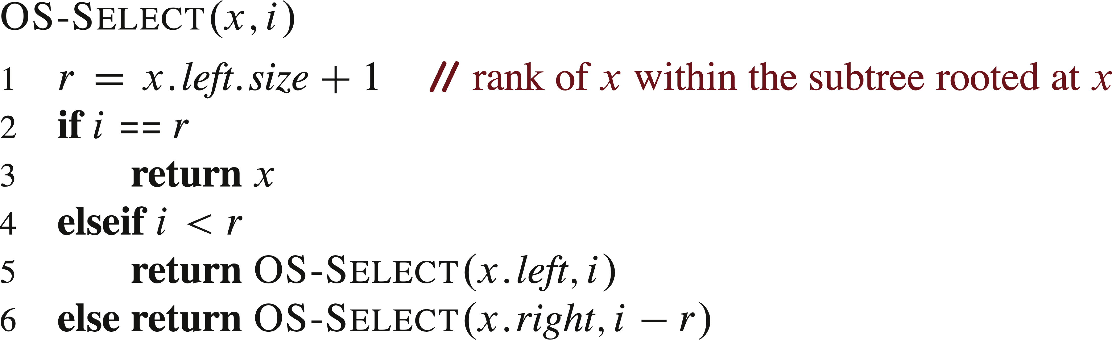
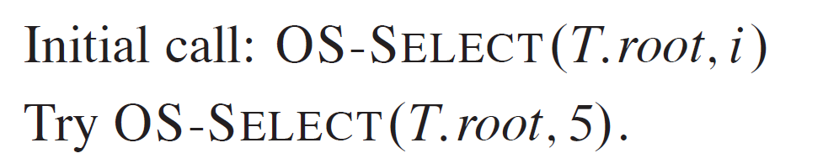
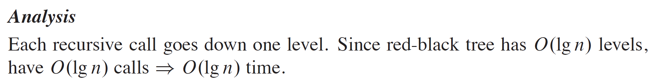
FIND THE ELEMENT WITH A GIVEN RANK

Slide 7
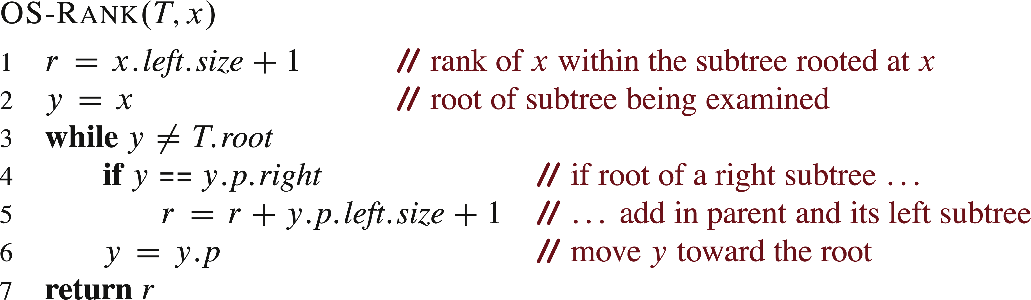

FIND THE RANK OF AN ELEMENT

Slide 8
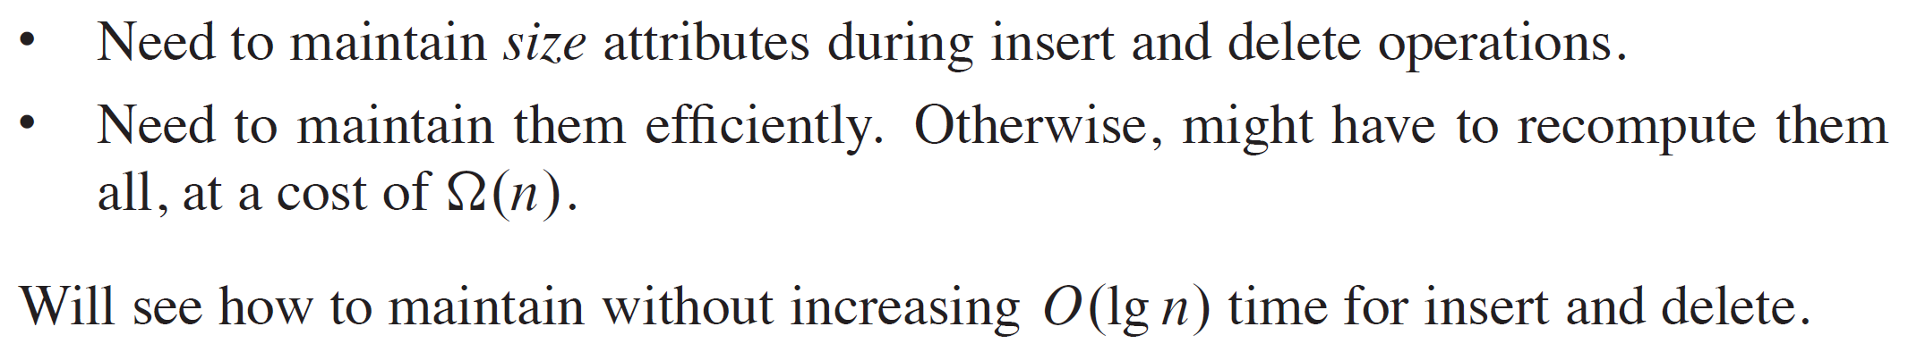
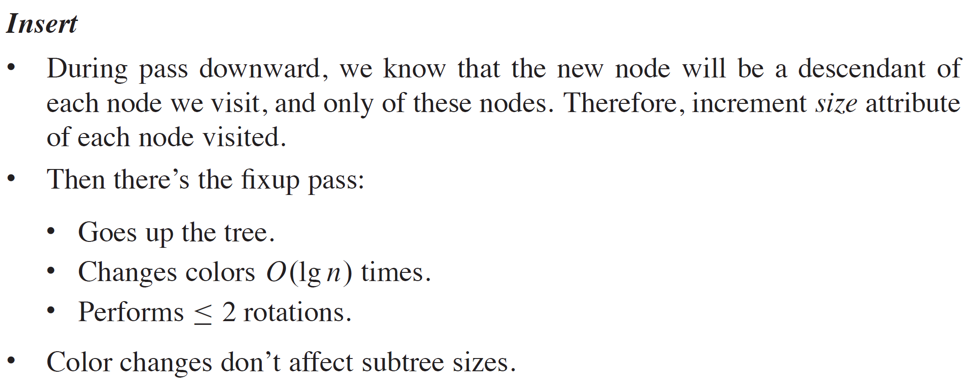
MAINTAINING STUBREE SIZES

Slide 9
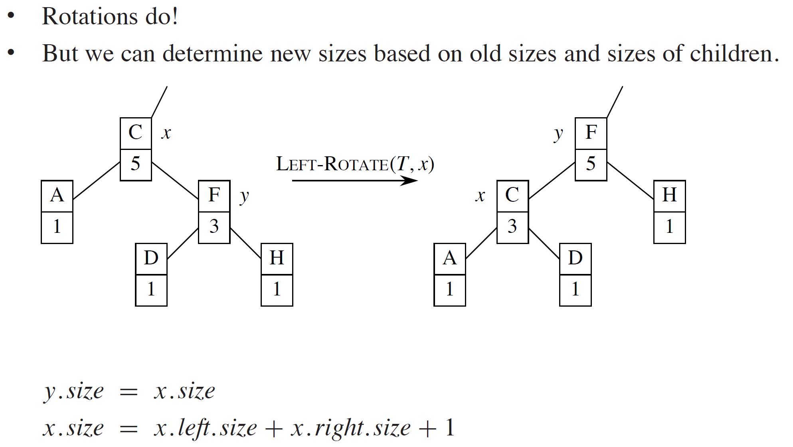
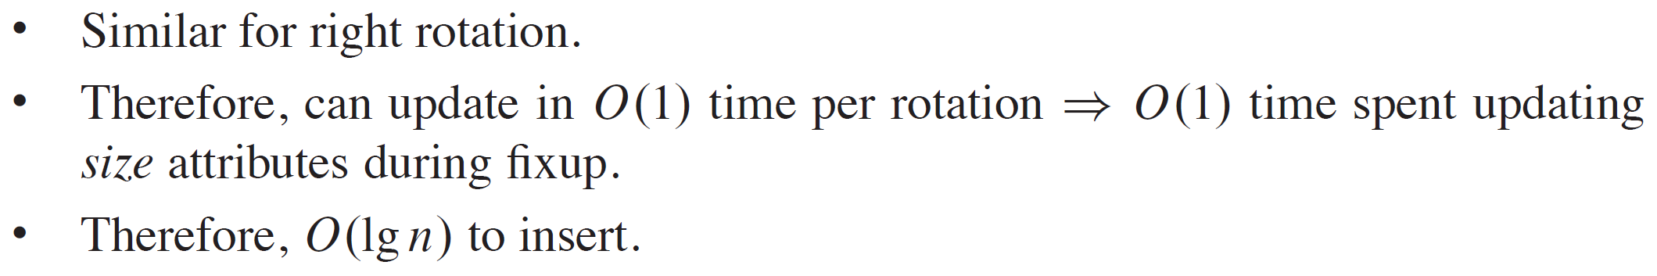
MAINTAINING STUBREE SIZES (continued)

Slide 10
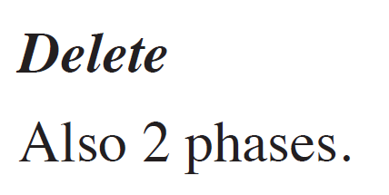
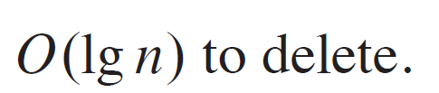
MAINTAINING STUBREE SIZES (continued)

Slide 11
METHODOLOGY FOR AUGMENTING A DATA STRUCTURE
Choose an underlying data structure.
Determine additional information to maintain.
Verify that you can maintain additional information for existing data structure operations.
Develop new operations.
Don’t need to do these steps in strict order!
Usually do a little of each, in parallel.

Slide 12
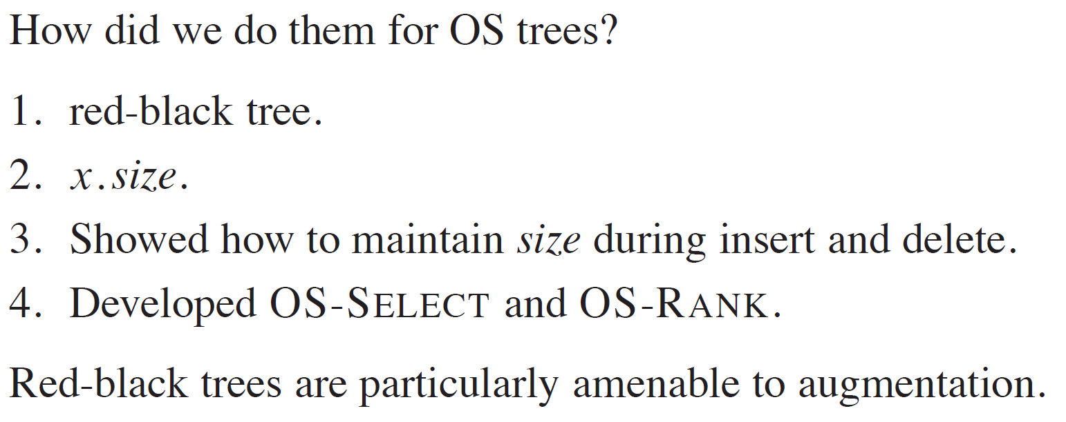
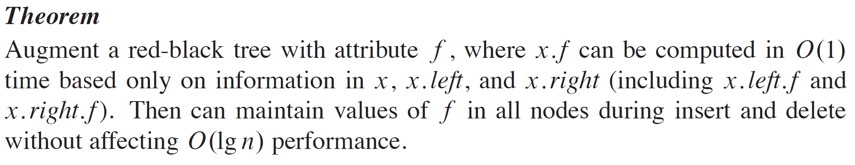
METHODOLOGY FOR AUGMENTING A DATA STRUCTURE (continued)

Slide 13
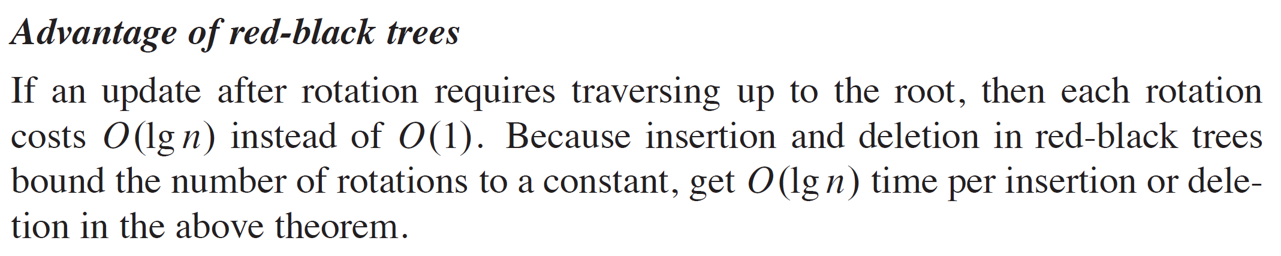
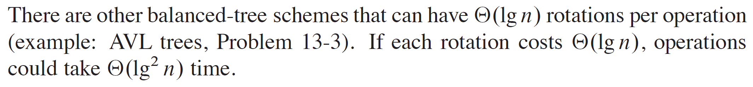
METHODOLOGY FOR AUGMENTING A DATA STRUCTURE (continued)

Slide 14
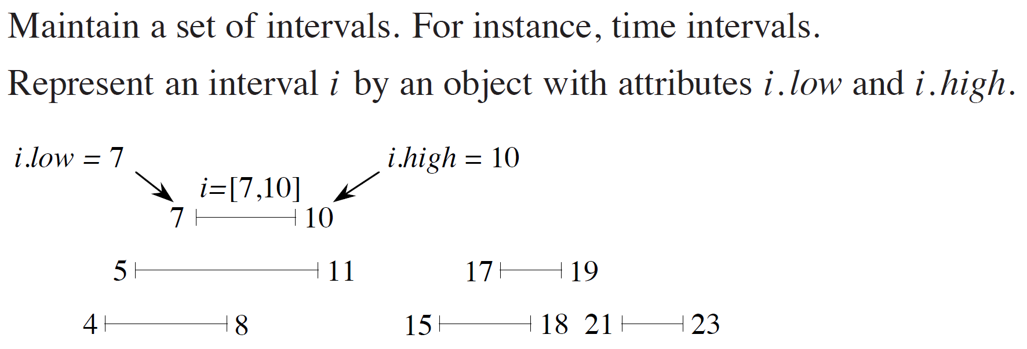
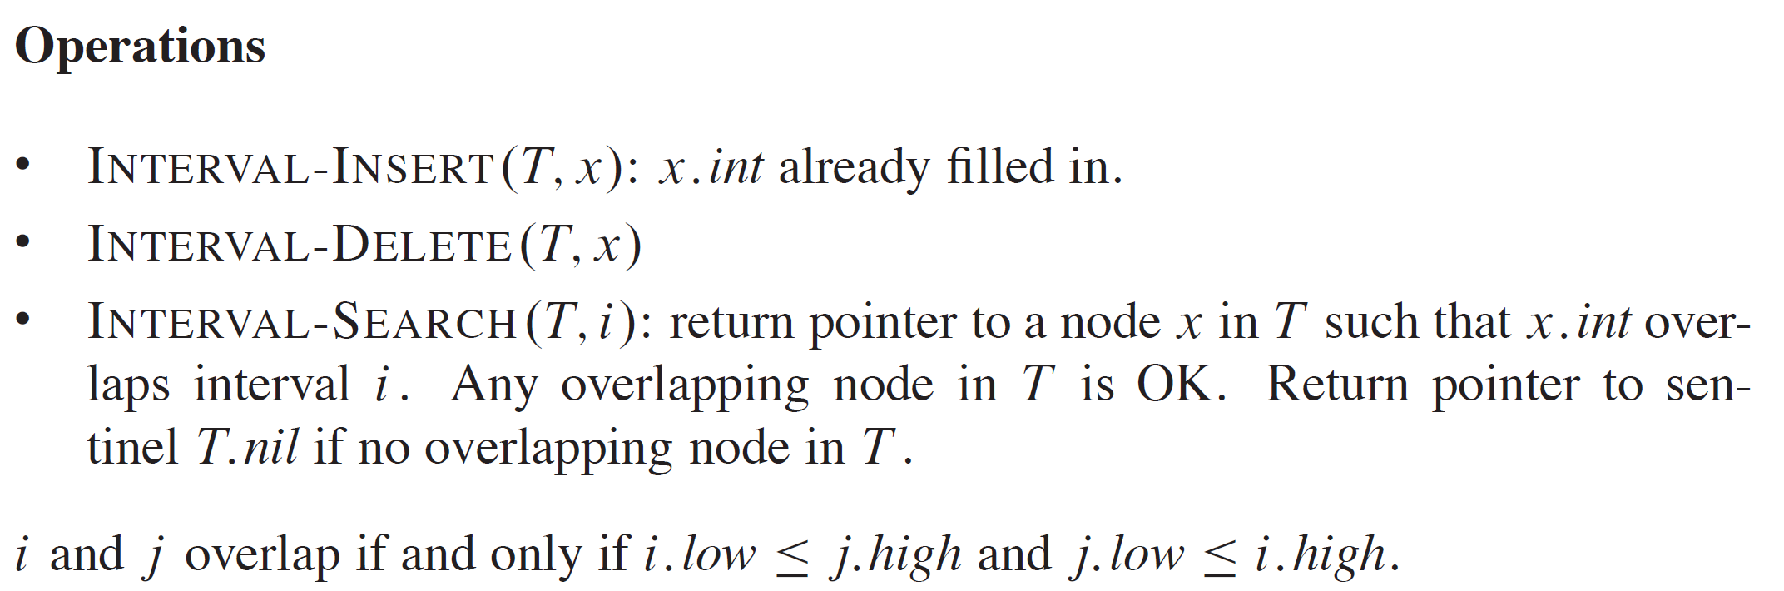
INTERVAL TREES

Slide 15
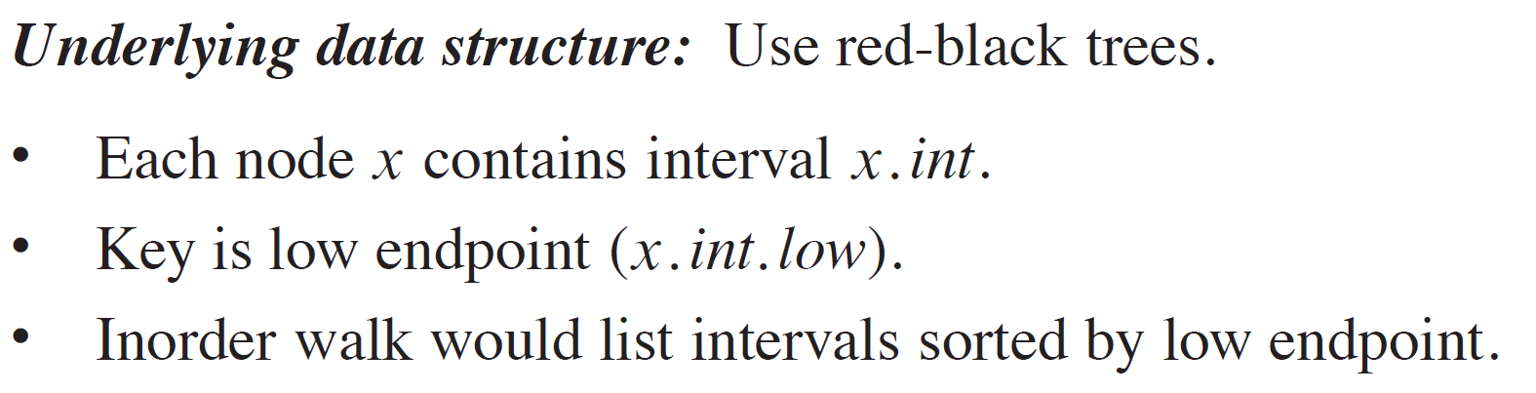
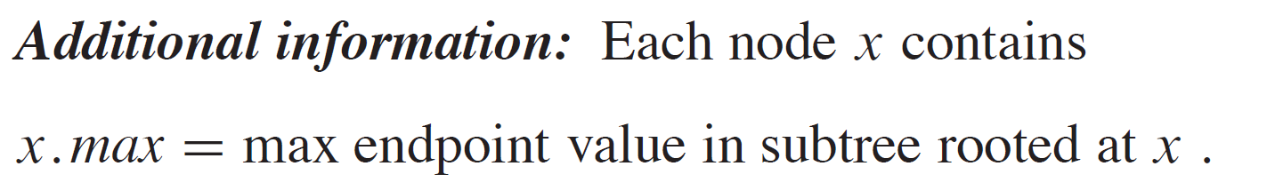
FOR INTERVAL TREES
Recall the 4-part methodology.

Slide 16
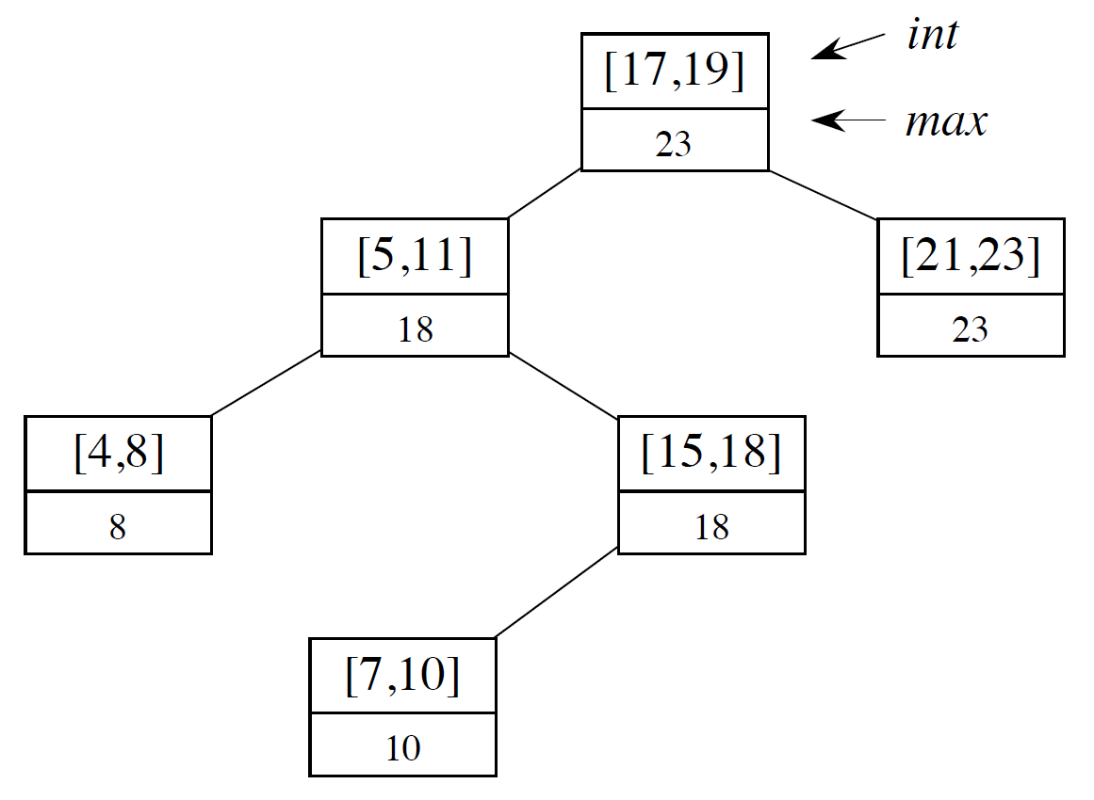
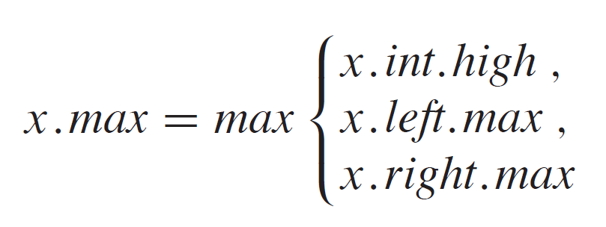
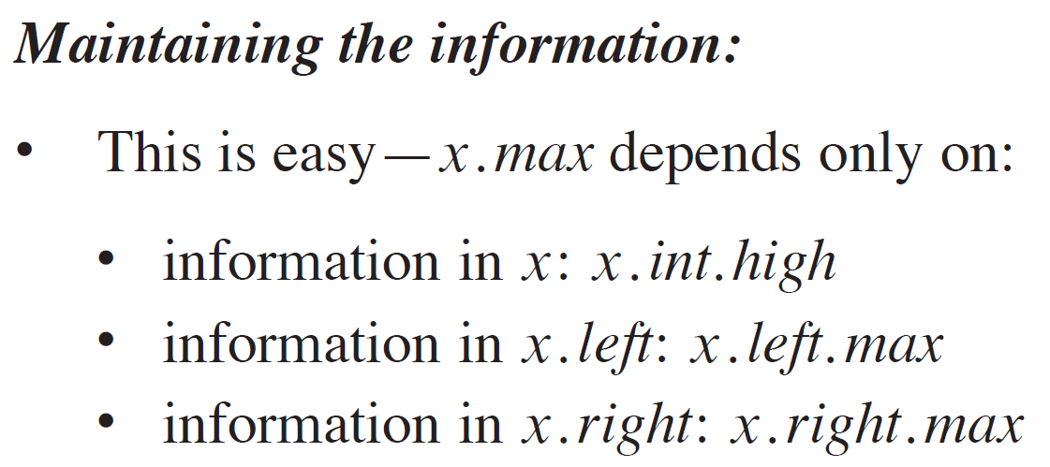
FOR INTERVAL TREES (continued)

Slide 17
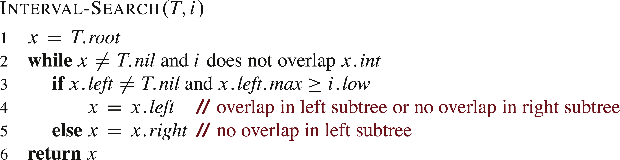
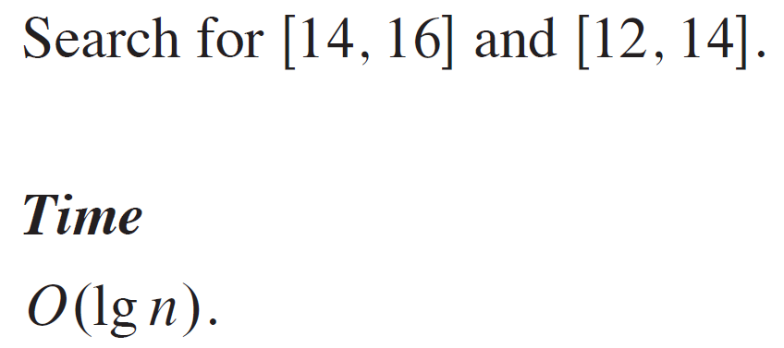
FOR INTERVAL TREES (continued)

Slide 18
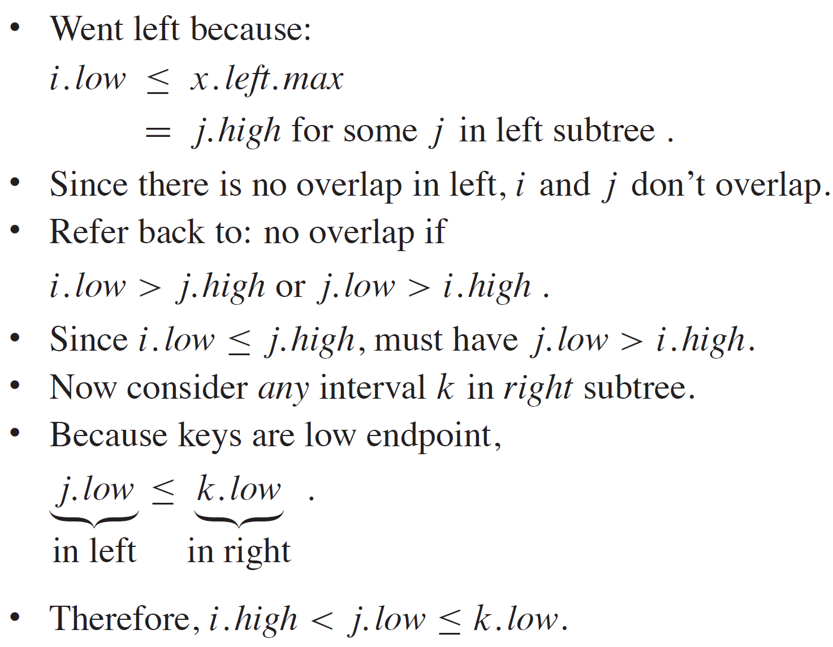
FOR INTERVAL TREES (continued)
If search goes left, then either:
There is an overlap in left subtree, or
There is no overlap in either subtree.
If search goes left:
If there is an overlap in left subtree, done.
If there is no overlap in left, show that there is no overlap in right.

